Slide 1

SAGA BUZZ
Presented By
Srikanth Gude
Anusha Nelluri
Gopi Nelluri
Achyuth Kumar Valeti

Slide 2

Introduction
SAGA Buzz is a one stop website for people interested in Films, TV Series, Celebrity articles, Box Office Collection, and lot more.
Audience can search for favorite movies, TV Shows, Box-Office information and celebrity information.
All the features are developed using various web developing tools.

Slide 3
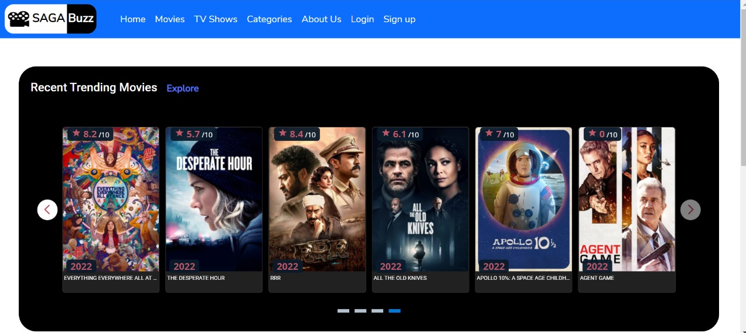
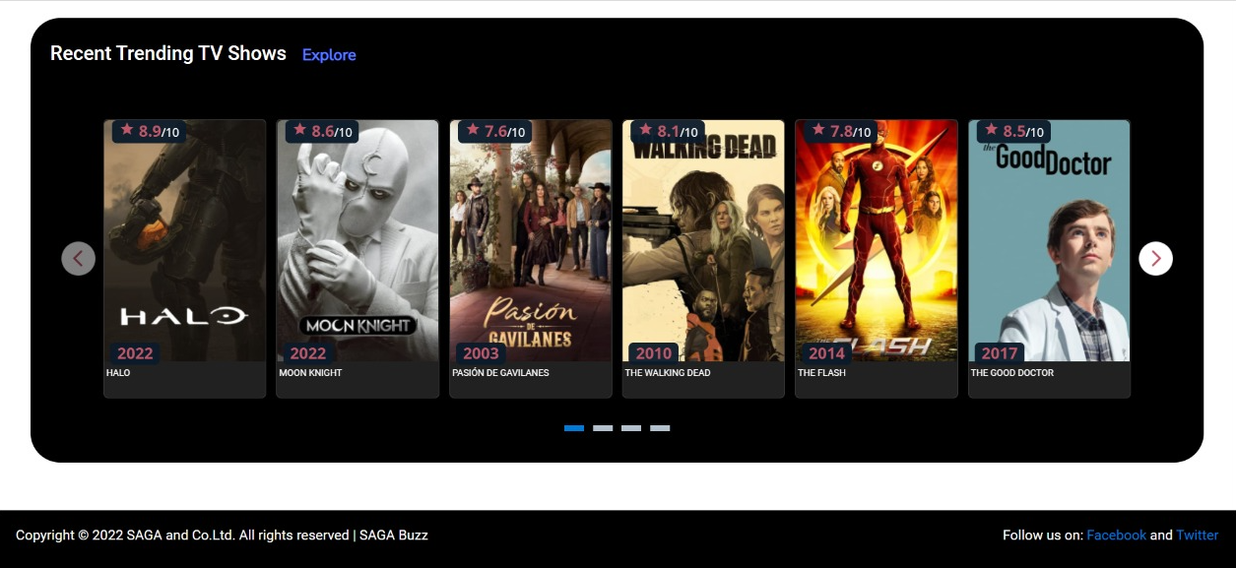
The content on the home page is primarily comprised of recent films and television series from across the world.
If audience wants to know more about different films and television series, they can use the slide bar to find more.
If audience still wants to explore more about other films and television series, they can use explore.

Slide 4
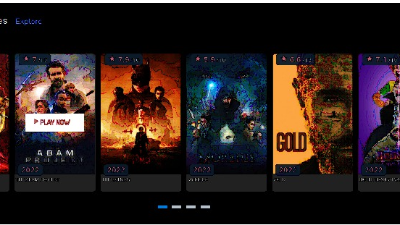
If audience wants to explore more about specific movie or tv show, ‘PLAY NOW’ button should be clicked. The page will then be redirected to the following pages, which includes an “overview”, “videos”, and “photos”.

Slide 5
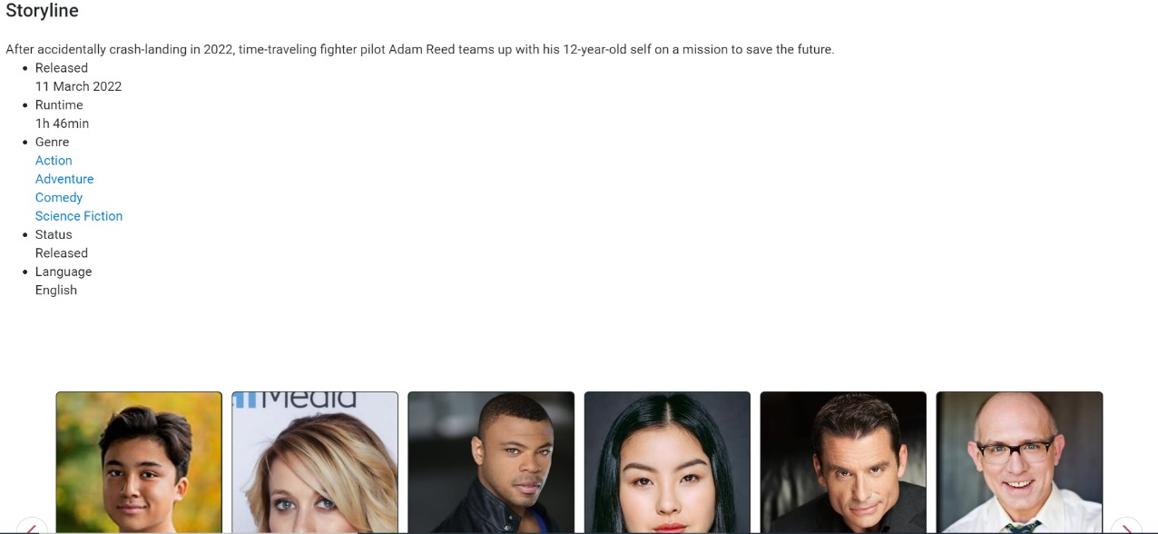

Overview
In this area, user may learn about the film’s or tv shows plot, release date, genre, status, cast and crew.

Slide 6
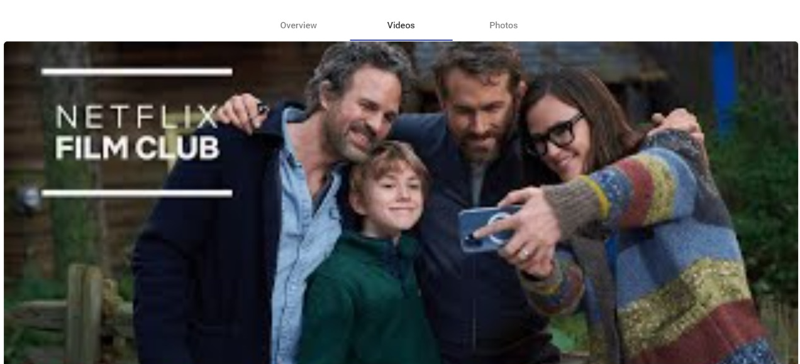
Videos
In this ‘Videos’ section, Viewers can watch trailers and related videos for each film or television show.

Slide 7
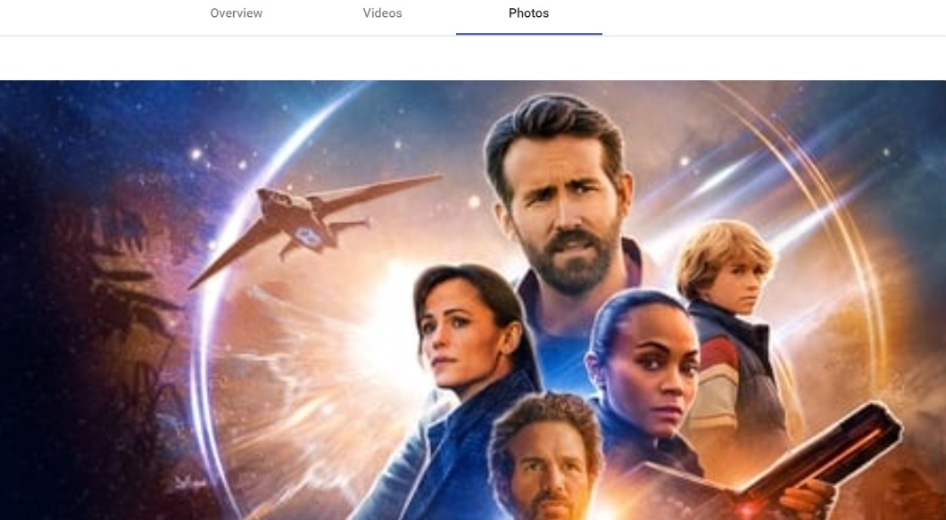
Photos
This section features the movie or television show's photos and photographs.

Slide 8
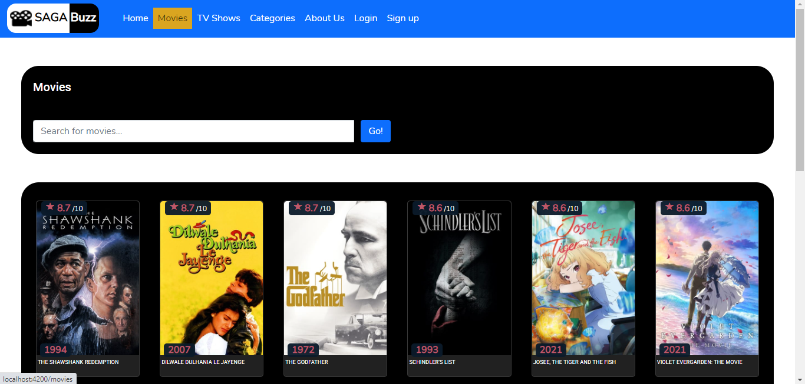
Movies
Viewers search more movies depending on their interest in the Movies section.
If users wish to see additional videos, they must utilize the slide option to move to the next page.

Slide 9
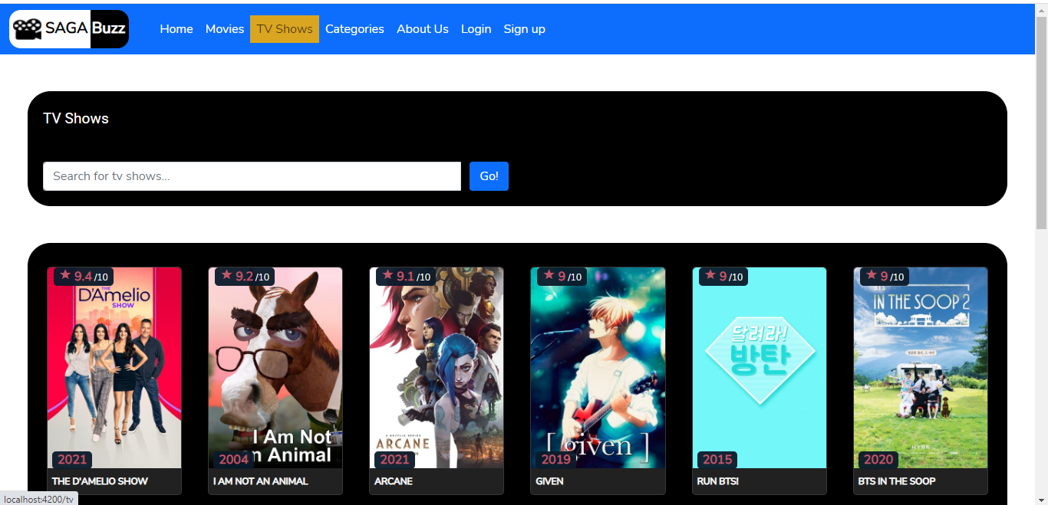
TV Shows
Viewers search more TV Shows depending on their interest in the TV Shows section.
If users wish to see additionally, they must utilize the slide option to move to the next page.

Slide 10
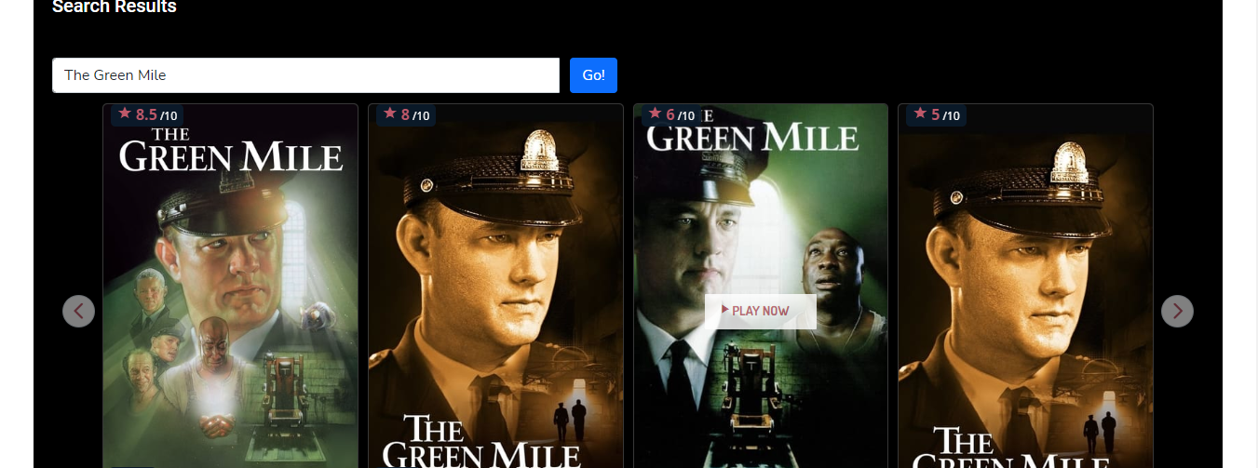
Search
A user may search for a certain movie by utilizing the search feature.
‘PLAY NOW’ button should be clicked. Then page will be redirected to the “overview”, “videos”, and “photos” pages as shown in the previous slides.

Slide 11
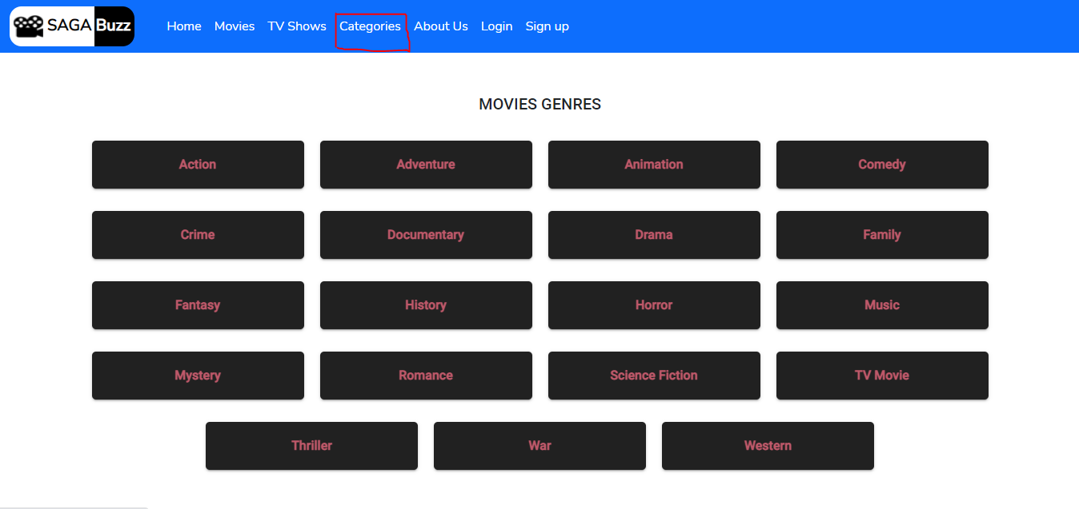
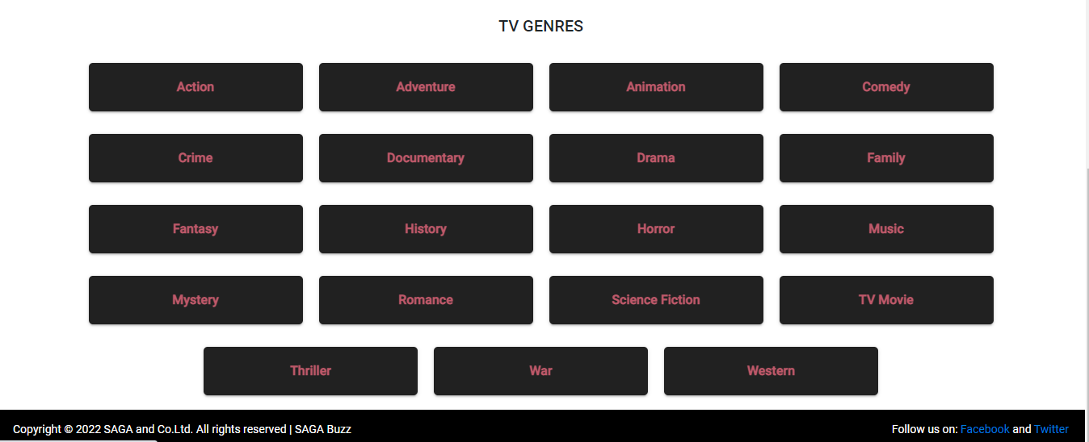
Categories
Audiences may pick from a variety of genres in movies and television series, such as Action, Adventure, Comedy, and Thriller, among others, in the Categories area.

Slide 12
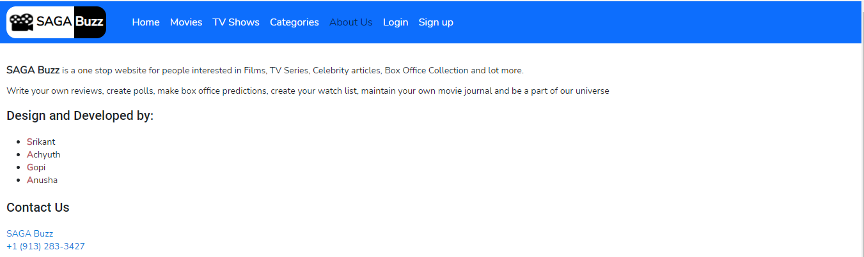
About Us
This section contains information on the SAGA Buzz website, such as a description, design development, and contact information.

Slide 13
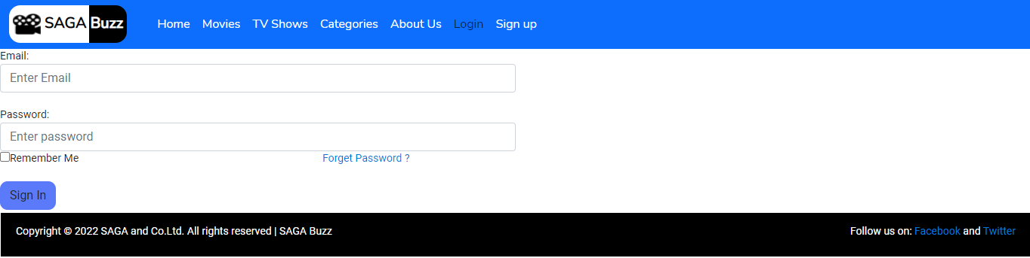
Login
Users can log in using their credentials on this page.

Slide 14
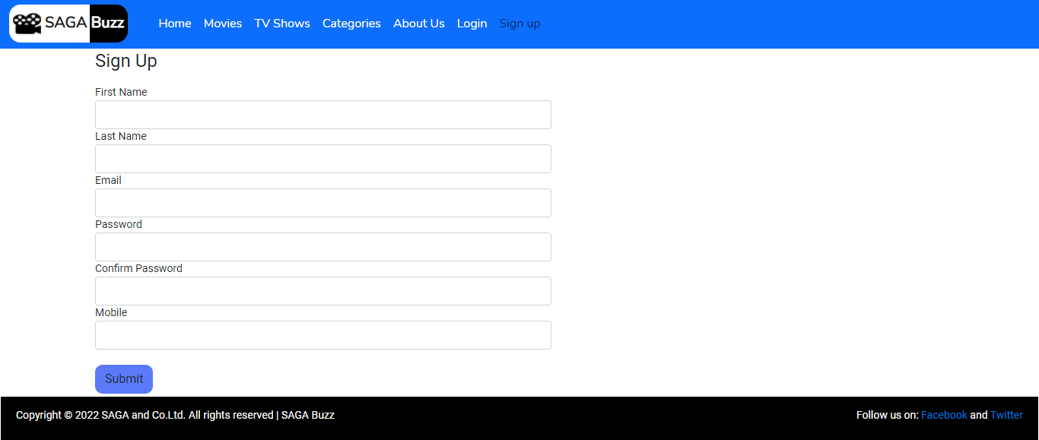
Sign Up
On this page, users may join up by providing information such as their name and email address.

Slide 15

YouTube Link: https://youtu.be/qZZrkSCJRUs
GitHub link: https://github.com/AchyuthValeti/SAGA-Reviews

